Slide 1
Gas Storage: Future role, barriers & solutions
David Dorsett, ERP Energy Storage Workshop, Thursday 14th April 2016

Slide 2
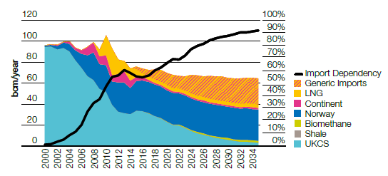
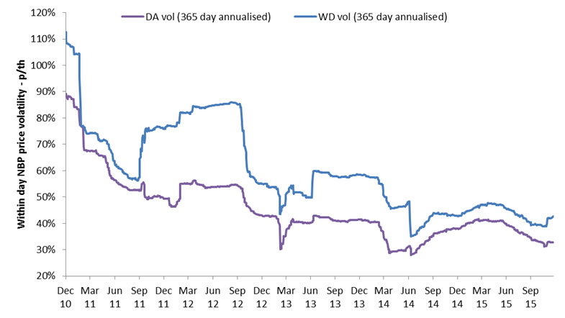
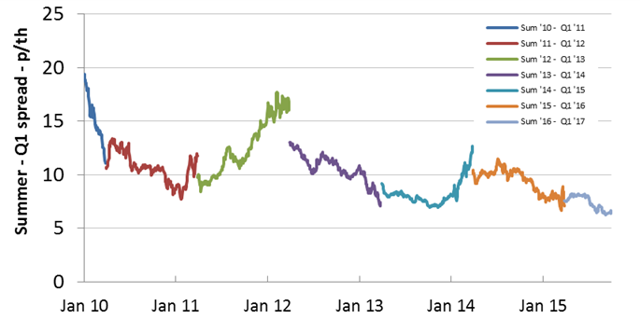
Gas Storage – Future Role & Barriers
Growth in gas imports under the Slow Progression scenario
Future Role
Essential to security of gas supply
At the centre of low carbon future - with more gas generation (15GW by 2030) & intermittent renewables
Barriers
Significant reduction in revenues due to deterioration in spreads & volatility
Full value of benefits not reflected
Business rates are unfair cost burden
Source: NGG FES July 2015
Spot Price Volatility 2010 / 2015
(DA = Day ahead, WD = within day)
Summer/Q1 NBP seasonal spreads history 2010 / 2015 (p/th)
Source: Centrica Storage Limited
Source: Centrica Storage Limited

Slide 3
Gas Storage – Future Role, Barriers, Solutions
Future Role
Essential contribution to Government’s energy security of supply policy; increased dependency on imported gas
At the centre of a low carbon future: closure of coal; intermittent renewable generation; more new gas fired power generation
However, viability is under threat with revenues falling dramatically, so will there be enough gas storage to fulfil the role?
Barrier | Y/N | Issue
Finance | Y | Unable to raise finance if future income < costs
Legal | N | No major issues
Commercial | Y | Low volatility & spreads Market does not reward full benefits of gas storage!
Political | Y | No appetite from Govt. to address unfair cost burden i.e. business rates to intervene to support revenues
Regulatory | Y | Burden of reporting / transparency requirements (REMIT) Uncertainty over future transportation tariffs
Possible Solutions
(proposed by GSOG)
Recognise the full value of the benefits provided by gas storage e.g. direct subsidies to “top-up” revenues
Reduce the cost burden – make business rates fair
Value the within day flexibility services gas storage can provide gas system e.g. via an obligation on National Grid
Reduce network (transportation) tariffs to reflect the real value of gas storage to the system

